Slide 1
MODULE 4
BIOMECHANICS AND BIOMATERIALS
Biomechanics of Joints: Skeletal Joints, Skeletal Muscles, Joint Function, forces and stresses in human joints, Mechanics of the Elbow, Shoulder, Spinal Column, Hip, Knee and Ankle, Applications of prosthetics.
Bio-fluid Mechanics: Circulatory System in the Human Body, Modeling of Flow in Blood Vessels, Blood Flow Theory.
Biomaterials: Definition and classification of biomaterials, biocompatibility and biodegradability, Biomedical Implants.

Slide 2
Biomechanics
Biomechanics is an interdisciplinary subject that seeks to understand the mechanics of living system. It is the mechanics applied to the biological system.
The skeletal system of the human body resembles a machine that is capable of doing useful work together with the bones regarded as links joints and soft tissues. The skeletal system offers a large range of movement and transmit large forces from one link to the other. Biomechanics helps to understand the relationship between structure and function predict changes due to alteration and propose methods of artificial intervention.
There are actually 700 different muscles in the human body which can be classified into three types. So, the muscles can be actually three types, skeletal muscles, cardiac muscles and smooth or visceral muscles. The skeletal muscles are attached to bones and they are as responsible for movement of the skeleton and they are designated as voluntary muscles.
The cardiac muscles are the muscles of the heart, they are designated as involuntary muscles examples in walls of blood vessels, intestine and other hollow structures and organs. The smooth or visceral muscle are the muscles of the viscera.
The functions of the muscles are as follows: muscles are responsible for motion; so all the motions that generally comes out of the human body are because of the muscle activation. It is responsible for maintenance of posture. it is also responsible for heat production.

Slide 3
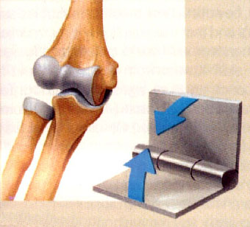
JOINTS & MOVEMENTS

Slide 4
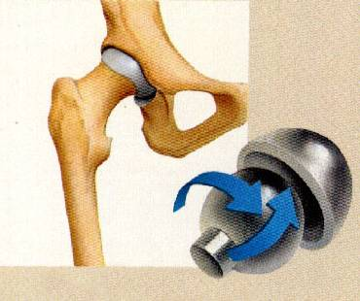
Objectives
By the end of the lecture, the student should be able to:
Name the 3 different types of joints.
Describe the structure of each type.
Name an example of each type.
Describe the movements which occur in each type.

Slide 5
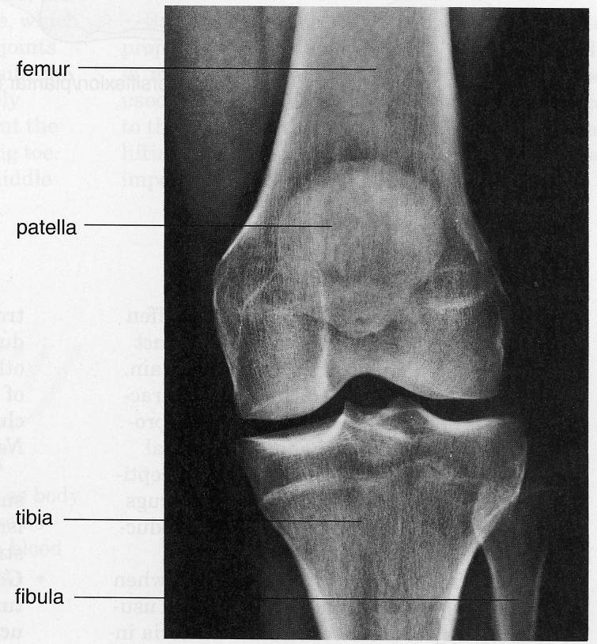
WHAT IS A JOINT ?
It is a meeting of two or more bones.
INTRODUCTION
Every bone in the body forms a joint with at least one or more bone, (except the hyoid bone in the neck).
Joints have two functions:
They hold the bones together securely.
Also it give the rigid skeleton mobility.
Femur
Patella
Tibia
Fibula
X-ray of the knee joint

Slide 6
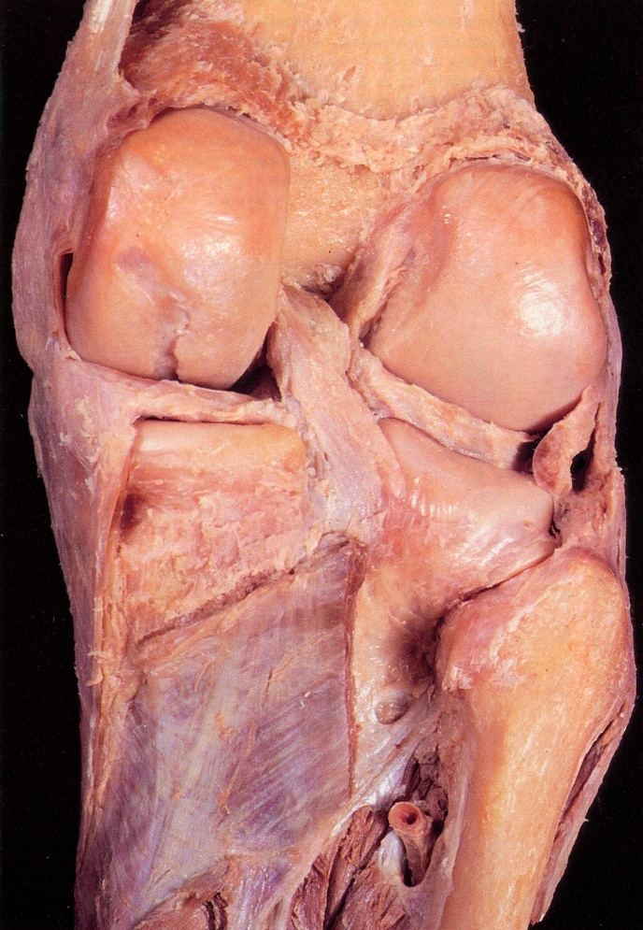
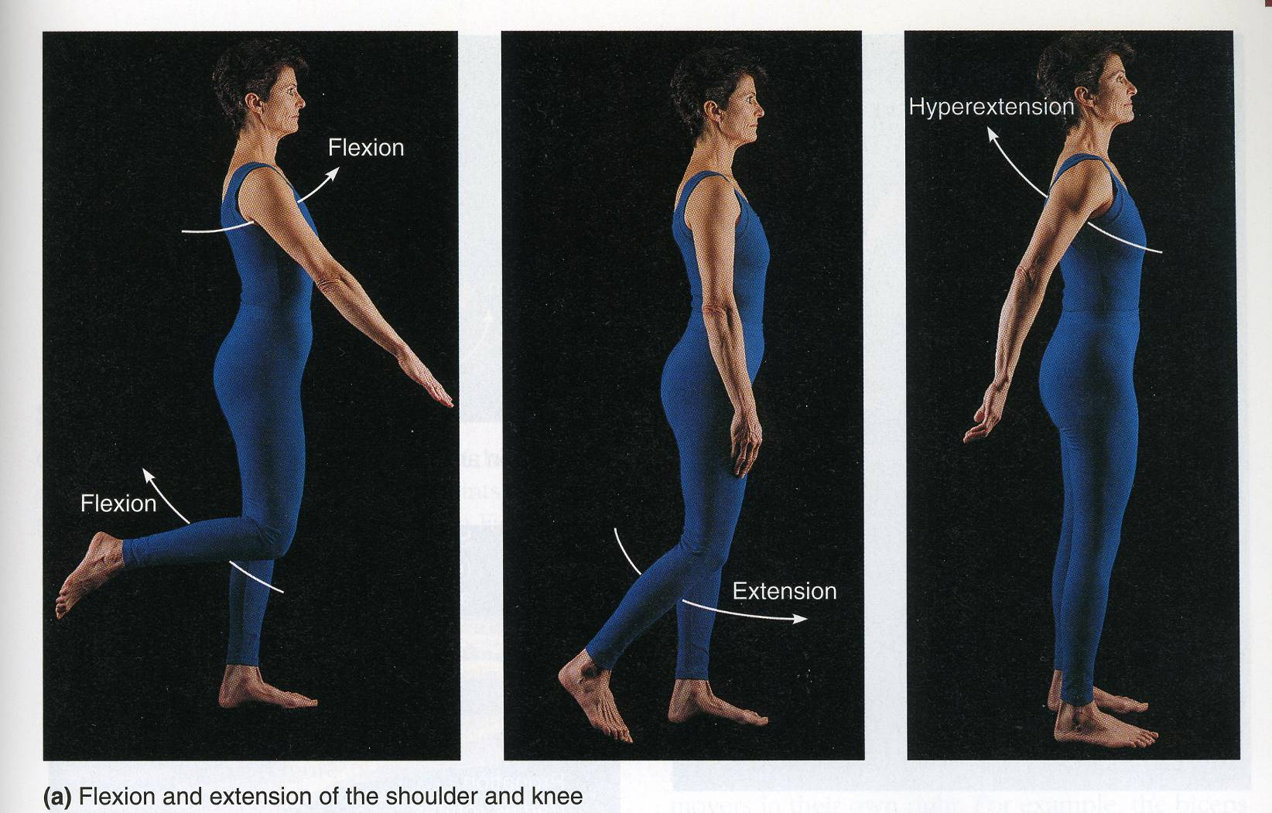
CLASSIFICATION
Joints could be classified by two ways:
According to function Or
According to structure.

Slide 7
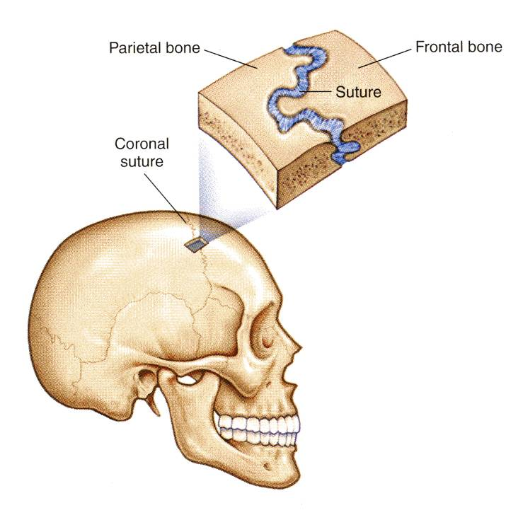
I- FUNCTIONAL CLASSIFICATION
1- Synarthroses or immovable joints,
2- Amphiarthroses or slightly movable joints.
3- Diarthroses or freely movable joints.
The functional classification depends on the amount of movement allowed by the joint.
On this basis, there are:
Synarthroses or immovable joints: Skull sutures.

Slide 8
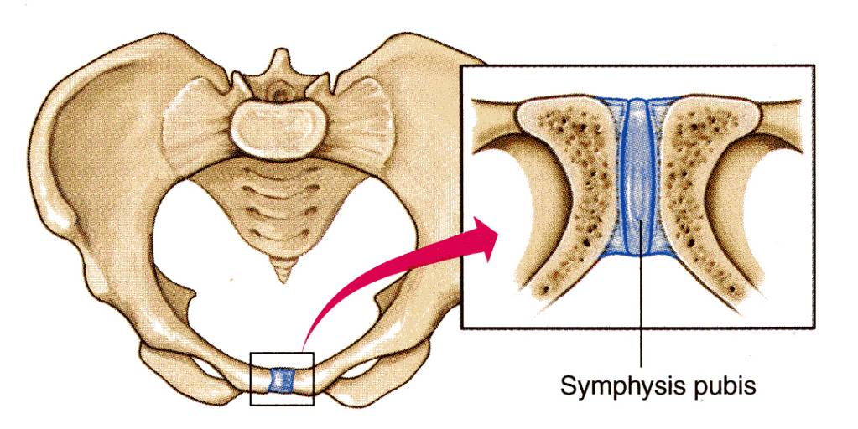
Amphiarthroses or slightly movable joints, e.g. Symphysis pubis.

Slide 9
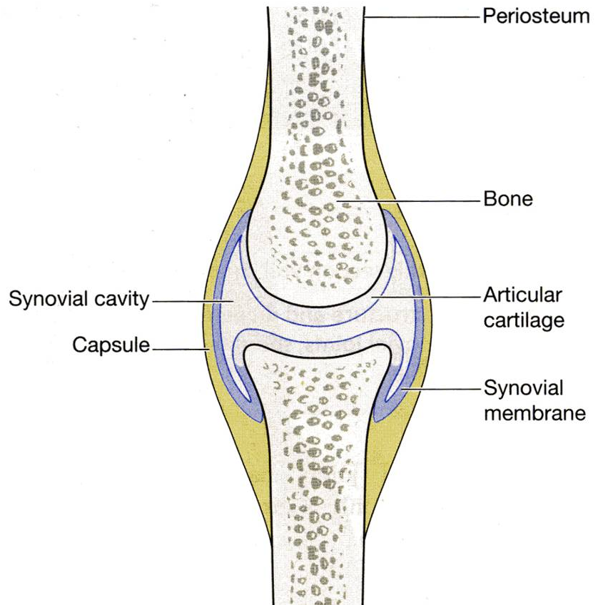
Diarthroses or freely movable joints, (synovial joint)

Slide 10
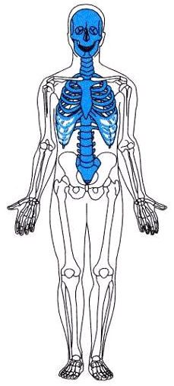
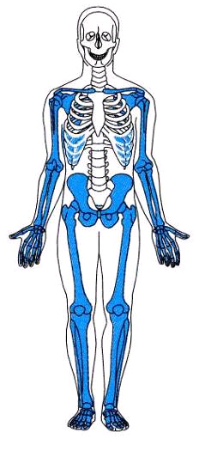
Immovable & slightly movable joints are restricted mainly to the axial skeleton, where firm attachments and protection of internal organs are priorities.
Freely movable joints predominate in the limbs, where mobility is important.

Slide 11
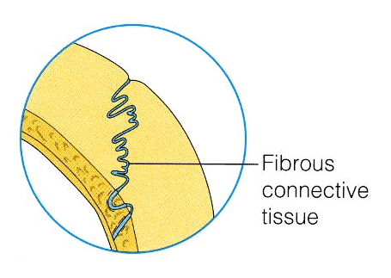
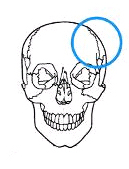
II- STRUCTURAL CLASSIFICATION
This classification depends upon the tissue which connects the bones.
There are three types of joints:
A. Fibrous,
B. Cartilage, or,
C. Synovial joint, where a joint cavity separates the bones.
They are called:
Fibrous joints: Skull sutures

Slide 12
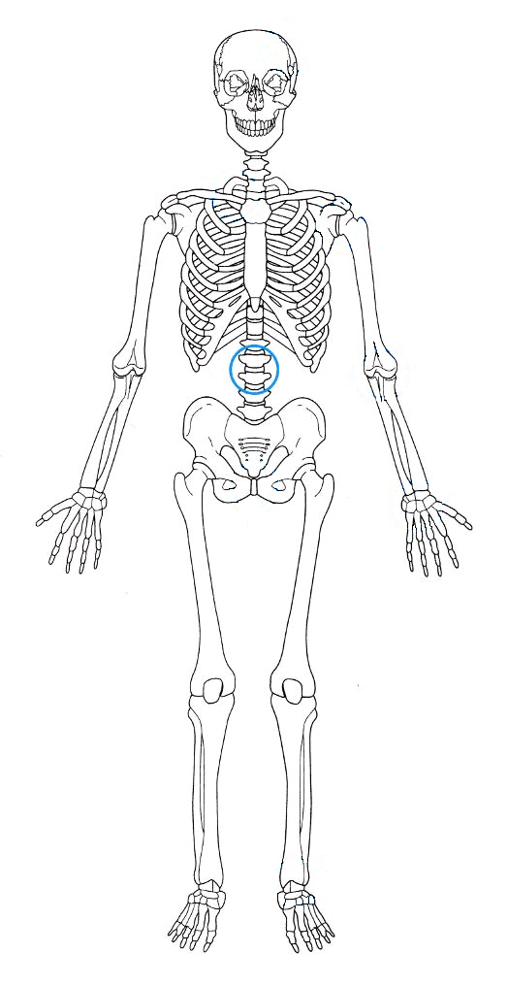
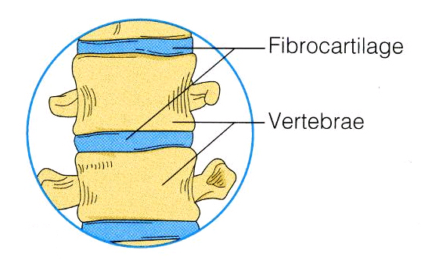
Cartilaginous joints: Intervertebral discs.

Slide 13
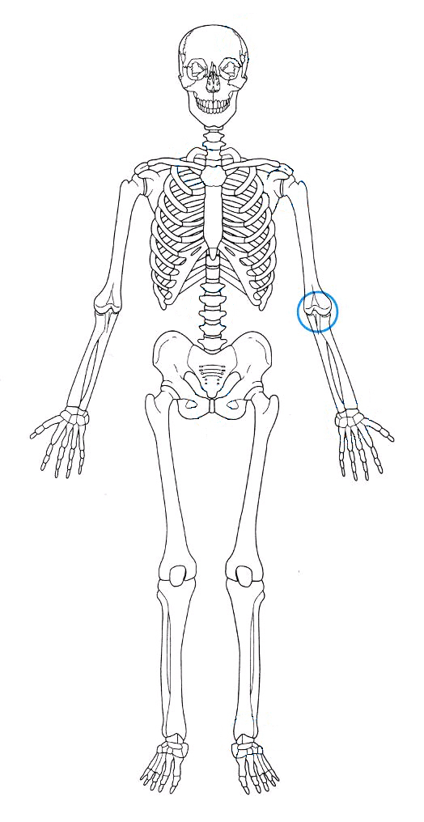
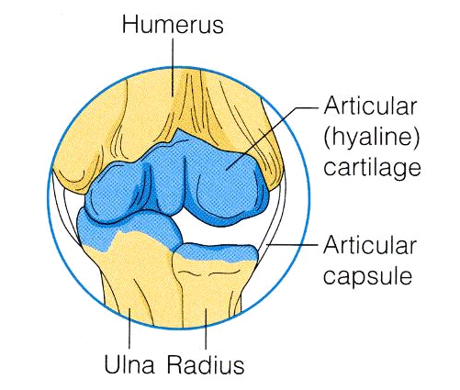
Synovial joints.

Slide 14
AS A GENERAL RULE:
fibrous joints are immovable
synovial joints are freely movable
most cartilaginous joints are slightly movable (amphiarthroses)

Slide 15

FIBROUS JOINTS
In fibrous joints, the bones are united by fibrous tissue.
Examples:
A- Skull sutures
In this joint, the irregular edges of bones interlock and are bound together tightly by fibers tissue, where no movement are allowed.

Slide 16
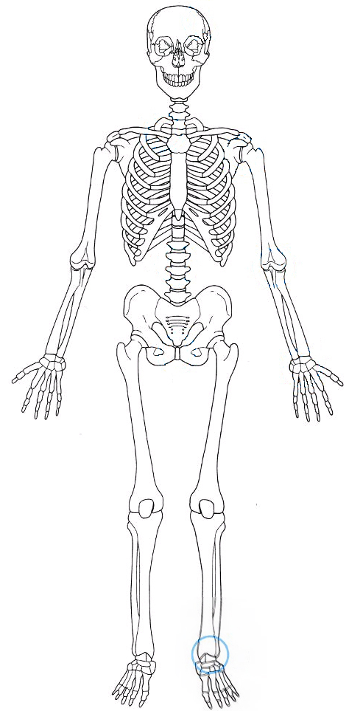
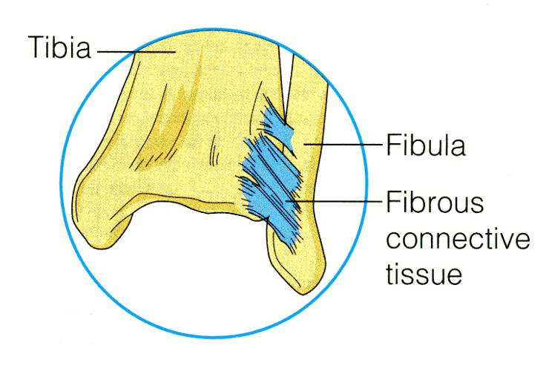
FIBROUS JOINTS
B- Inferior tibiofibular joint, where no or very minimal movement is allowed.
It is called syndesmoses.

Slide 17
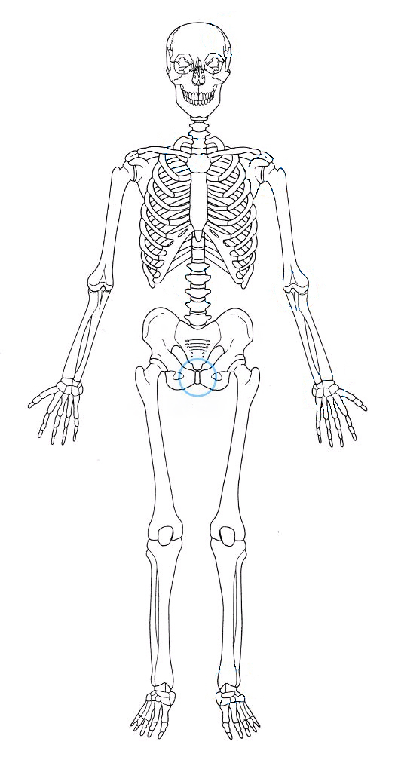
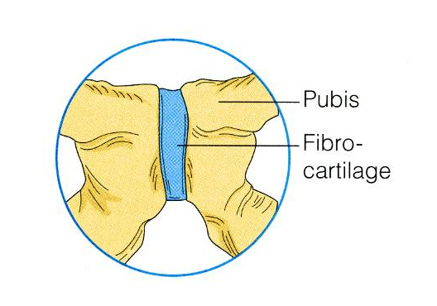
CARTILAGINOUS JOINTS
In cartilaginous joints, the 2 bone ends are connected by cartilage.
Examples:
Pubic symphysis of the pelvis (slightly movable (amphiarthroses)

Slide 18
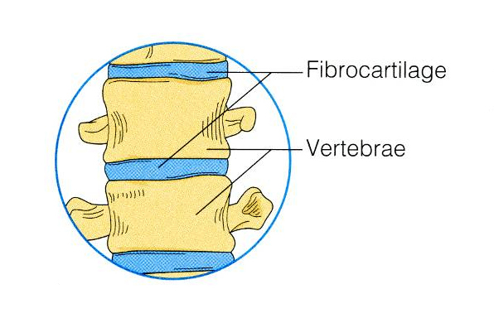
CARTILAGINOUS JOINTS
The intervertebral discs of the vertebral column, where the articulating bone surfaces are connected by pads (discs) of fibrocartilage, are also slightly movable (amphiarthroses) .

Slide 19
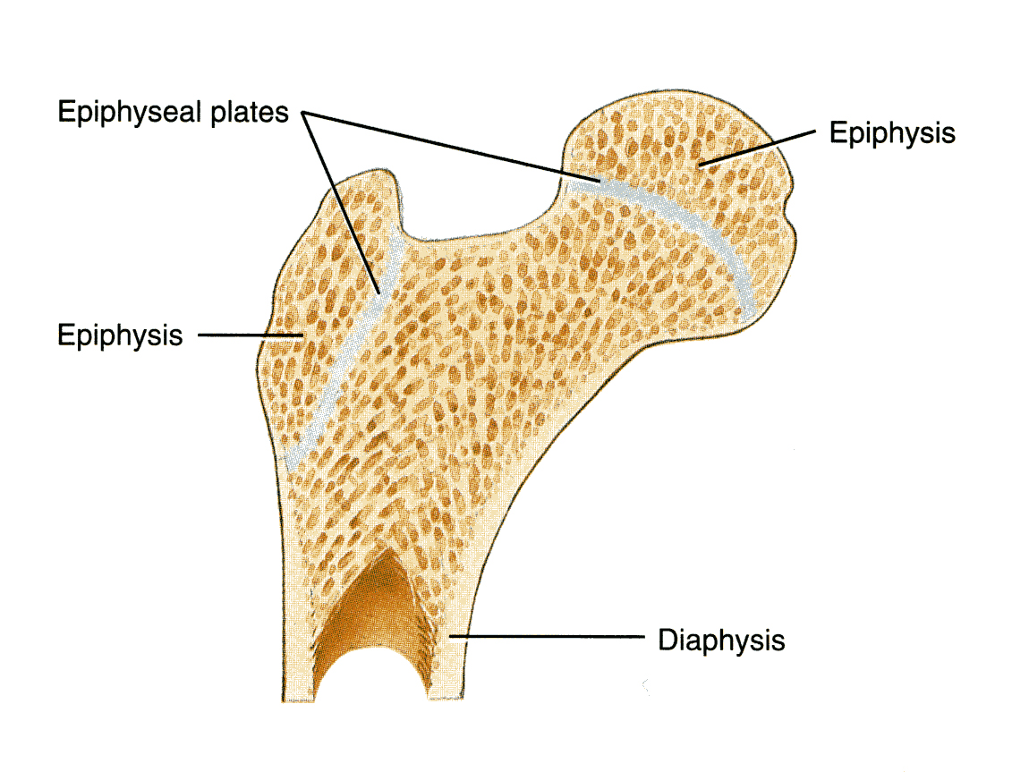
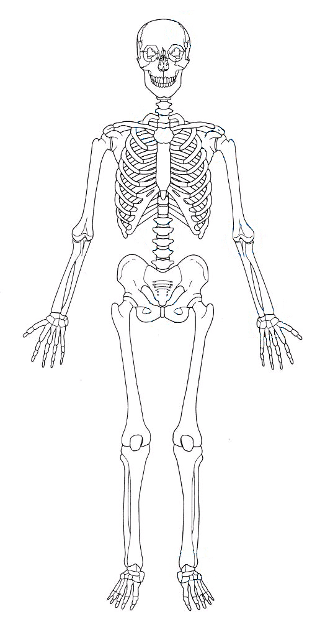
REMEBER !
The hyaline-cartilage Epiphysial plates of growing long bones are immovable (synarthroses) cartilaginous joints.

Slide 20
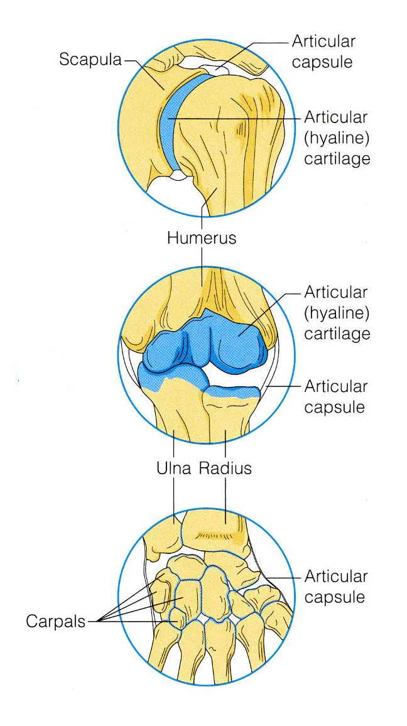
SYNOVIAL JOINTS
Synovial joints are those in which the articulating bone ends are separated by a joint cavity which contains a synovial fluid.
They account for all joints of the limbs.

Slide 21
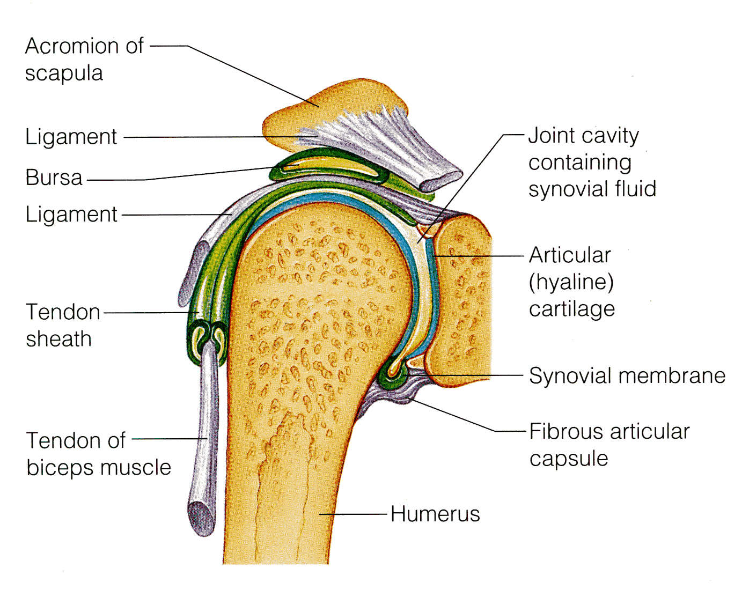
FEATURES OF SYNOVIAL JOINTS
1- Articular cartilage.
2- Fibrous capsule.
3- Synovial membrane
4- Joint cavity.
5- Extracapsular ligaments.
Articular cartilage.
The 2 ends of the bones are covered by articular (hyaline) cartilage.

Slide 22
Fibrous capsule.
The joint surfaces are enclosed by a fibrous capsule.
3. The capsule is lined with a synovial membrane.

Slide 23
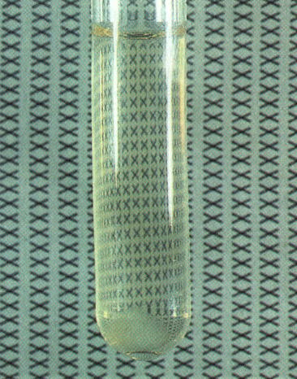
4. Joint cavity
Inside the synovial membrane there is a lubricating (synovial fluid).

Slide 24
5. Reinforcing ligaments.
The fibrous capsule is usually reinforced with ligaments. (extracapsular ligaments).

Slide 25
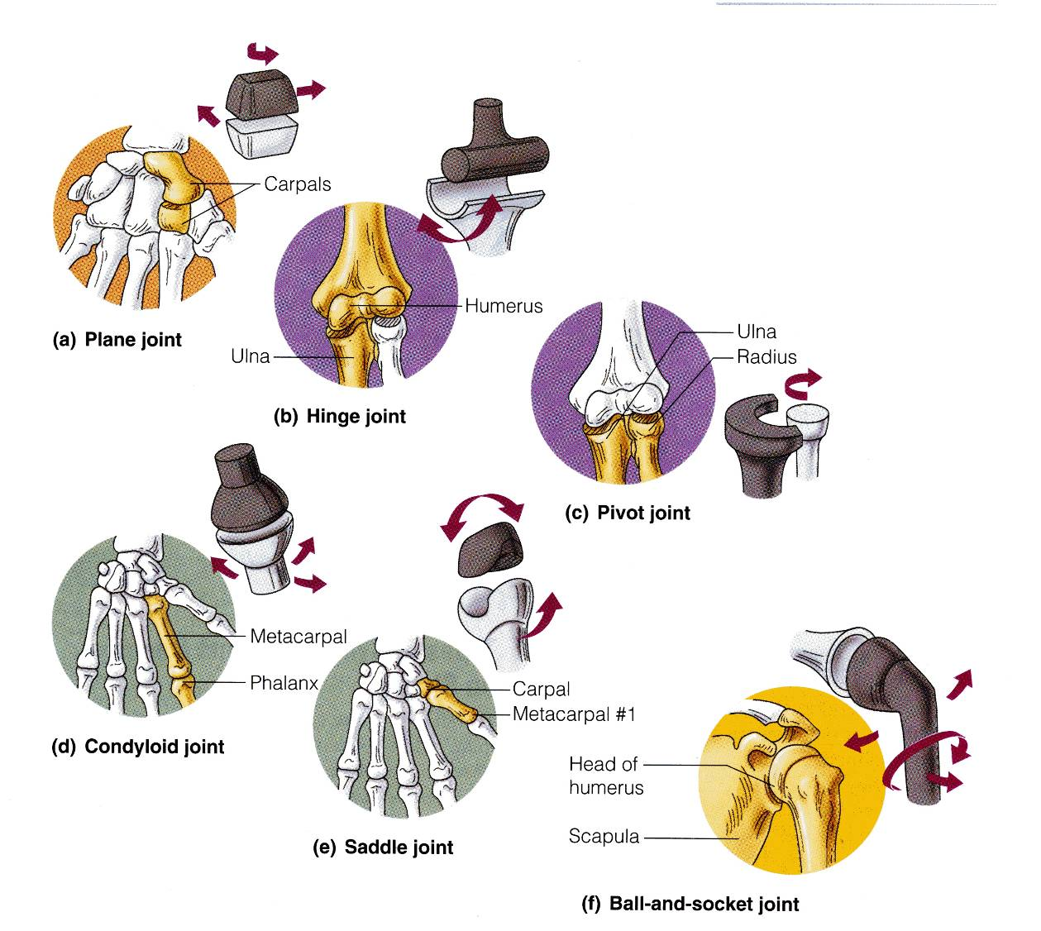
TYPES OF SYNOVIAL JOINTS BASED ON SHAPE
Based on the shape, the synovial joints can be classified as:
Plane,
Hinge,
Pivot,
Condyloid,
Saddle,
Ball and socket.

Slide 26
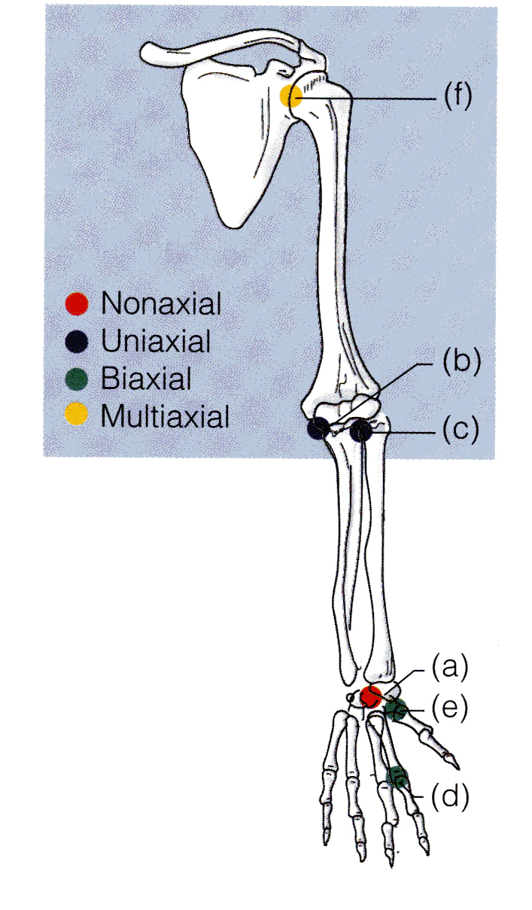
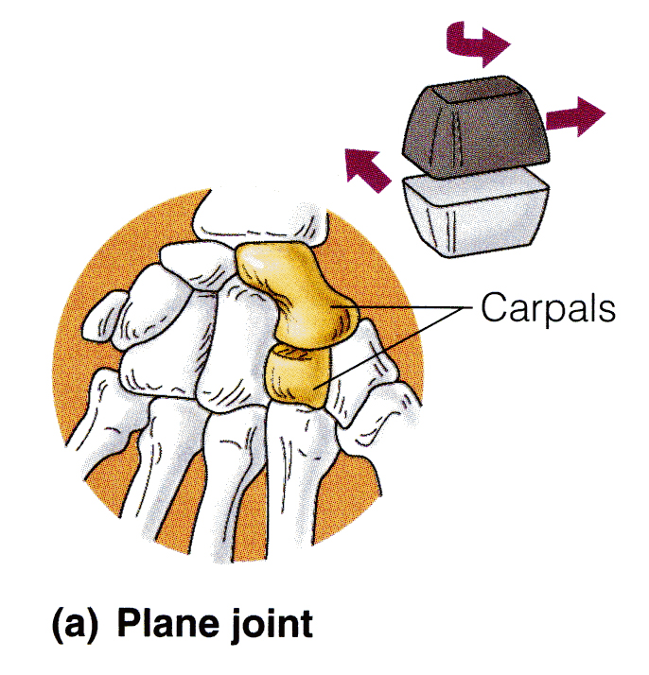
PLANE JOINTS
In a plane joint, the articular surfaces are flat, and only short slipping or gliding movements are allowed.
Example: The intercarpal joints of the wrist.

Slide 27
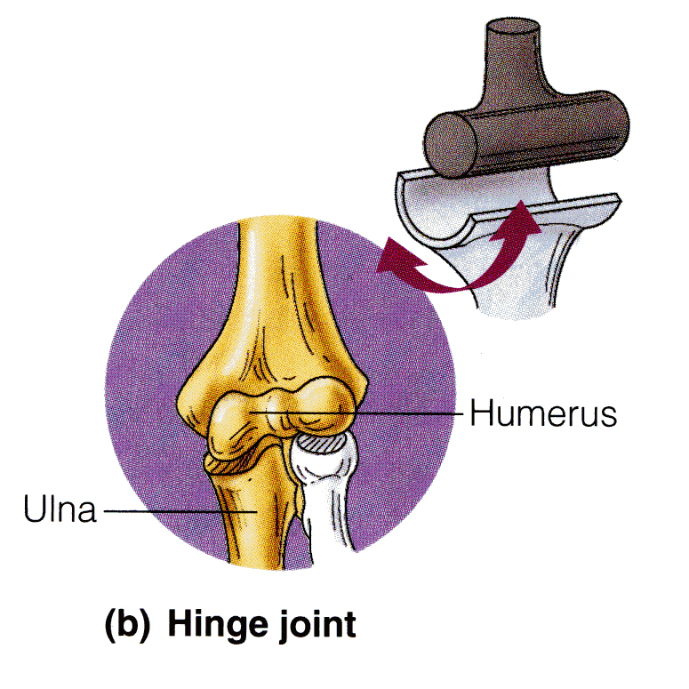
HINGE JOINTS
In a hinge joint, the cylindrical end of one bone fits into a trough-shaped surface on another bone.
Movement is allowed in just one plane, like a hinge.
Hinge joints are Uniaxial ; they allow movement around one axis only.
Examples: elbow & ankle, the interphalangeal joints of the fingers.
Axis of movement

Slide 28
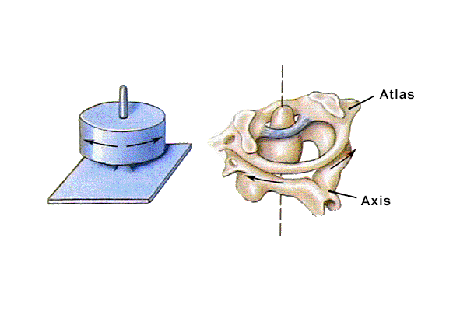
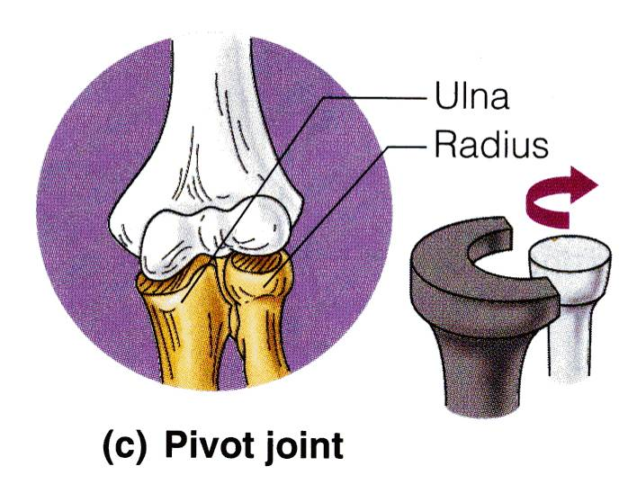
PIVOT JOINT
In a pivot joint, the rounded end of one bone fits into a ring of bone (or ligaments).
Pivot joints are Uniaxial joints, because bone can turn only around its long axis,
Examples: proximal or superior radioulnar joint & Median atlantoaxial joint.
Axis of movement

Slide 29
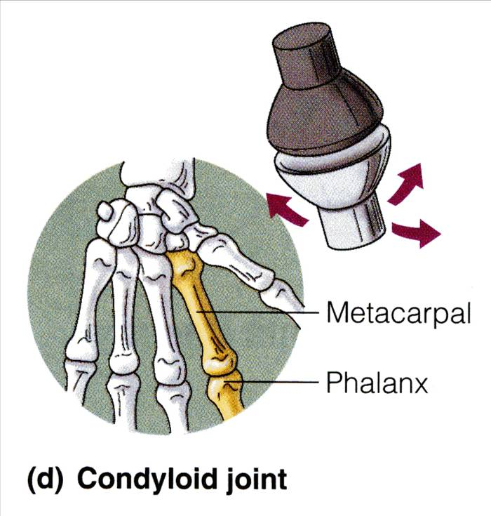
CONDYLOID JOINTS
In a condyloid joint, the egg-shaped articular surface of one bone fits into an oval concavity in another.
Both of these articular surfaces are oval.
Movement occurs around two axes, hence these joints are biaxial, as in knuckle (metacarpophalangeal joints).
Condyloid joints allow the moving bone to move:
from side to side and
back and forth,
but the bone cannot rotate around its long axis.
Axes of movement

Slide 31
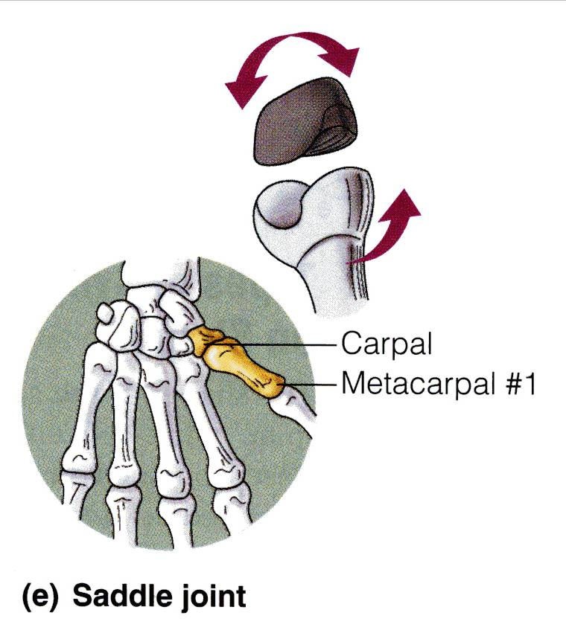
SADDLE JOINTS
Axes of movement
In saddle joints, each articular surface has both convex and concave areas, like a saddle.
These biaxial joints allow essentially the same movements as condyloid joints, but there is slight rotation.
Example: carpometacarpal joint of the thumb.

Slide 32
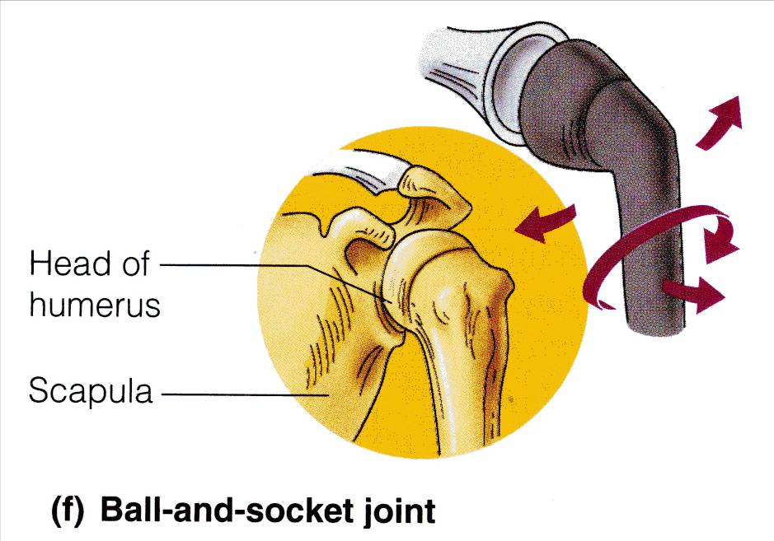
BALL-AND-SOCKET JOINTS
In a ball & socket joint, the spherical head of one bone fits into a round socket in another.
I t is a multiaxial joints allow movement in all axes, including rotation, and are the most freely movable joints.
Examples: shoulder and hip.

Slide 33

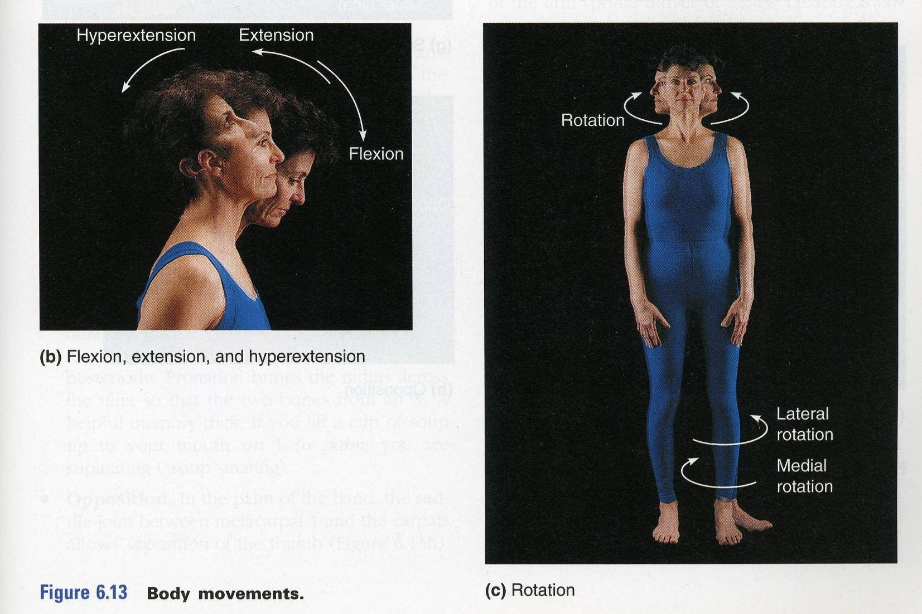
FLEXION, EXTENSION & HYPEREXTENSION
MOVEMENTS

Slide 34
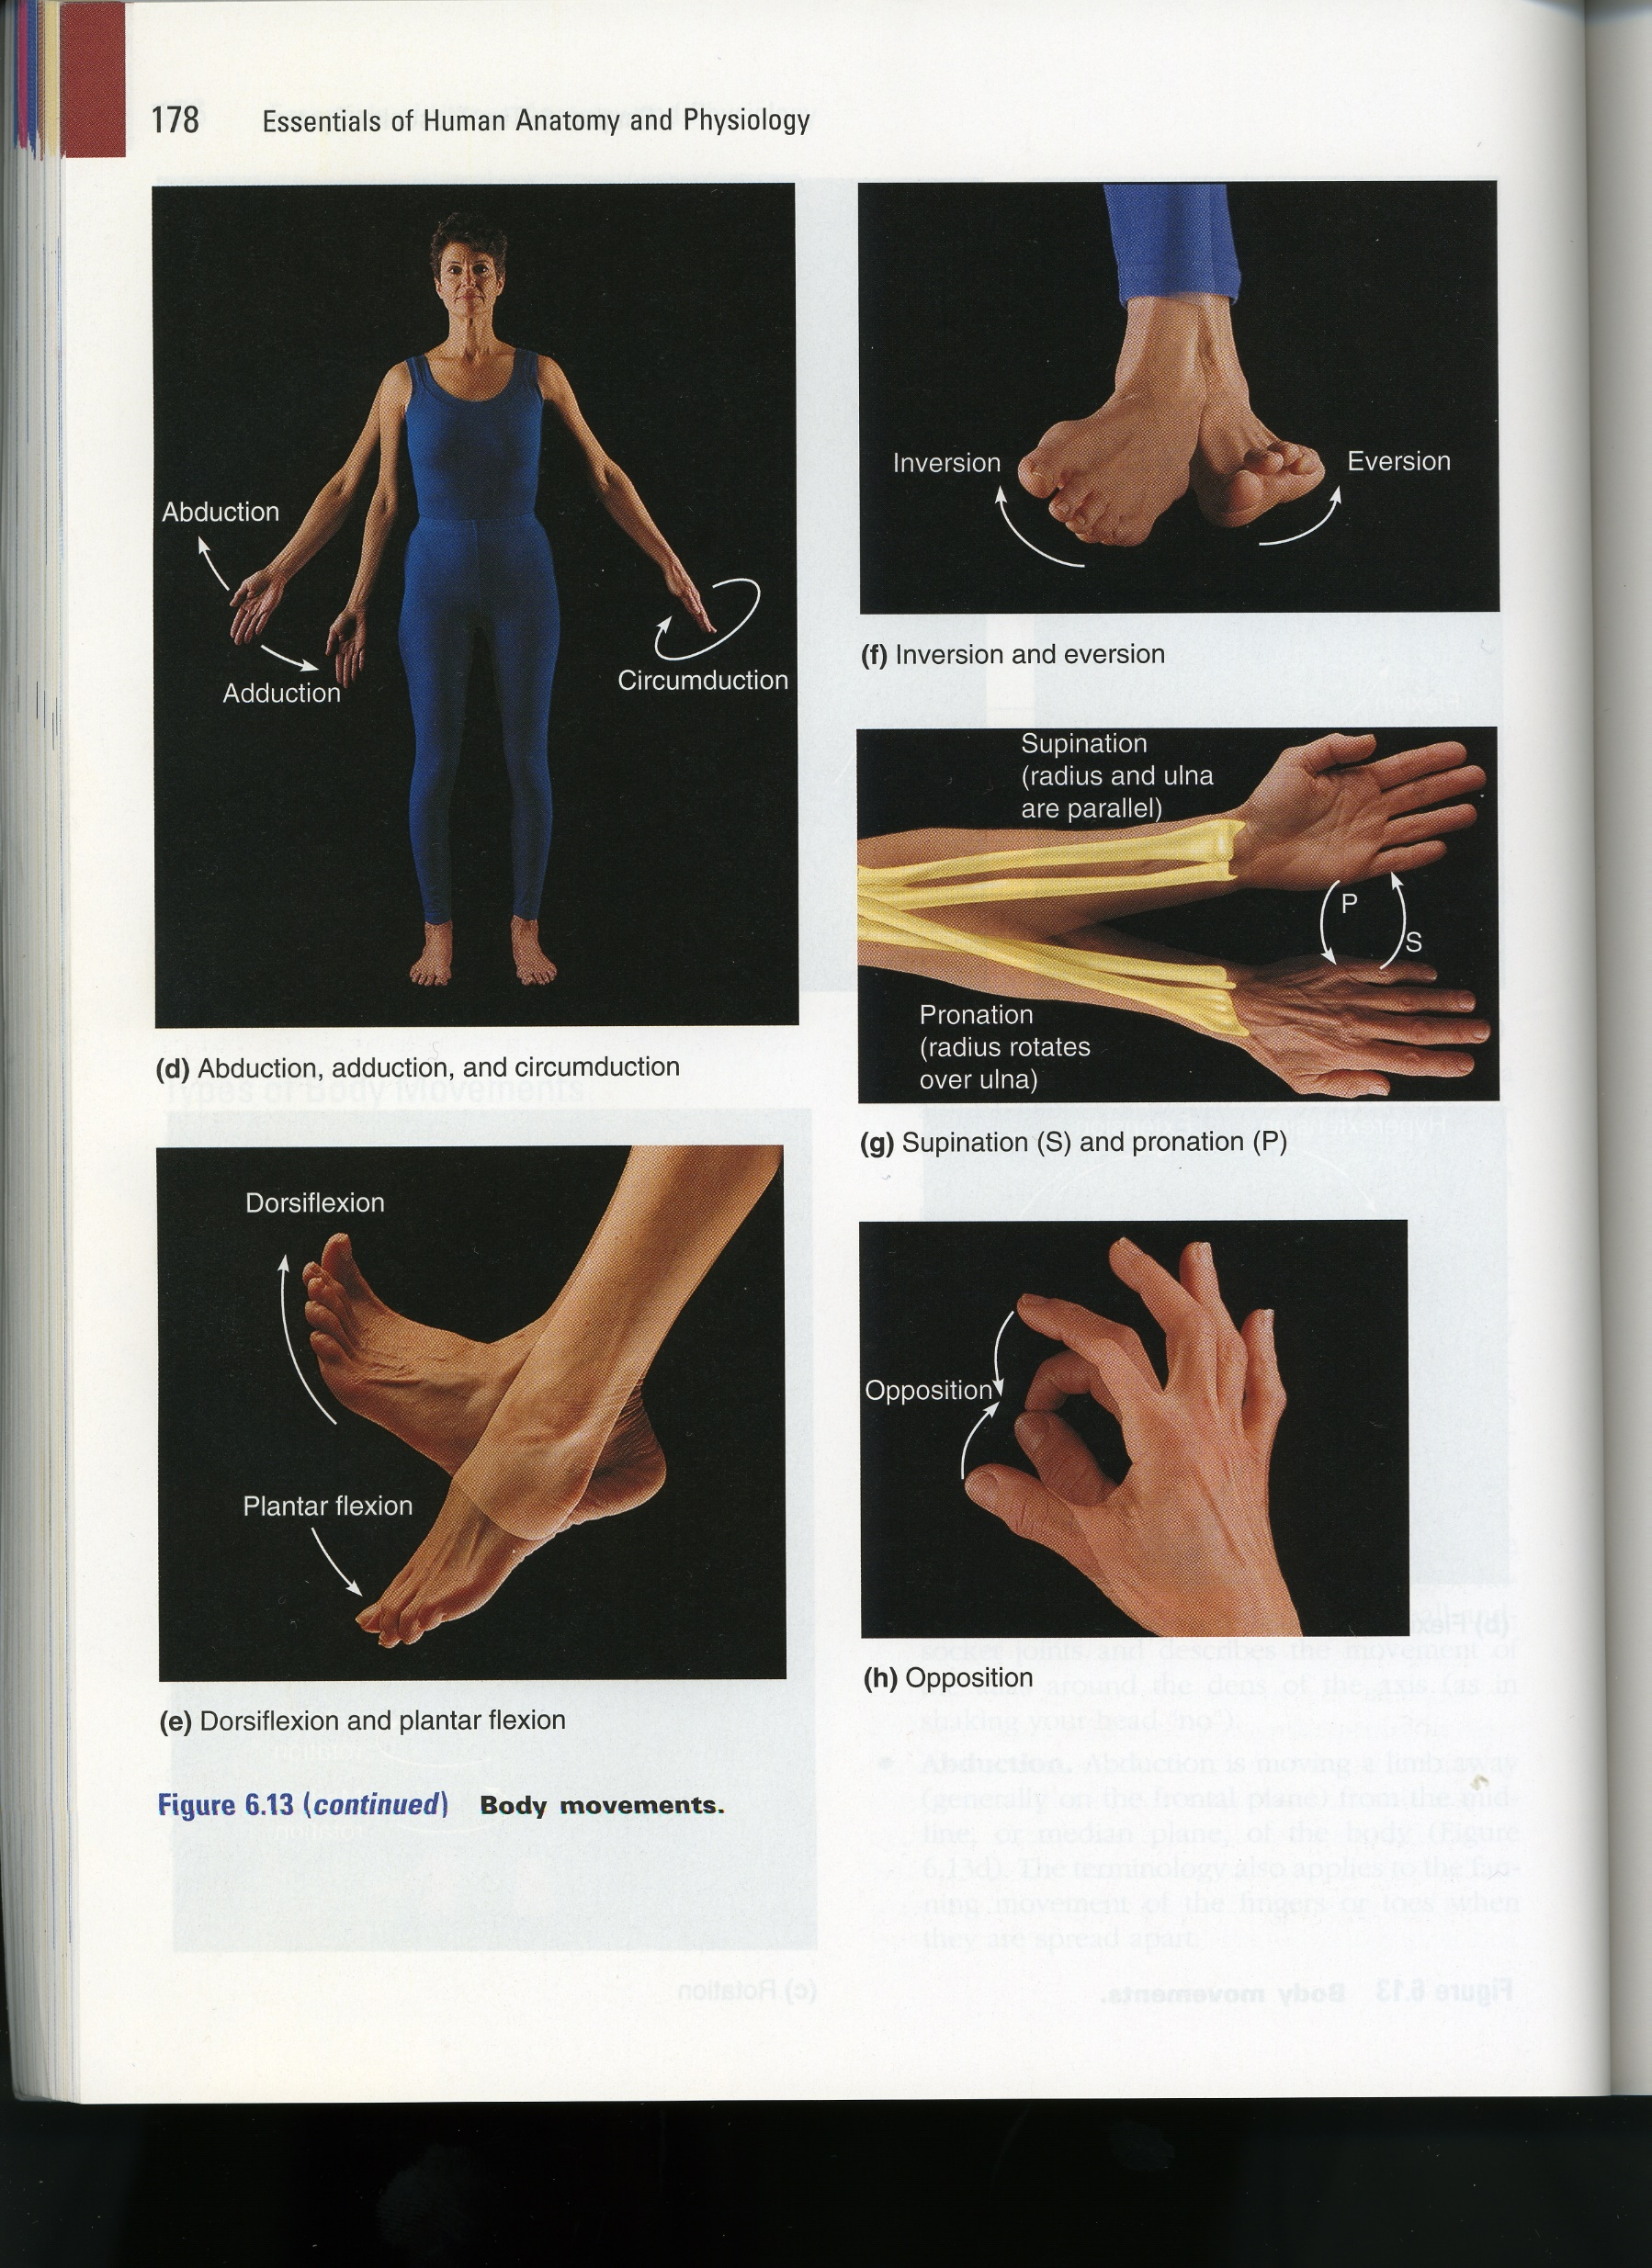
ABDUCTION, ADDUCTION, CIRCUMDUCTION
ROTATION

Slide 35
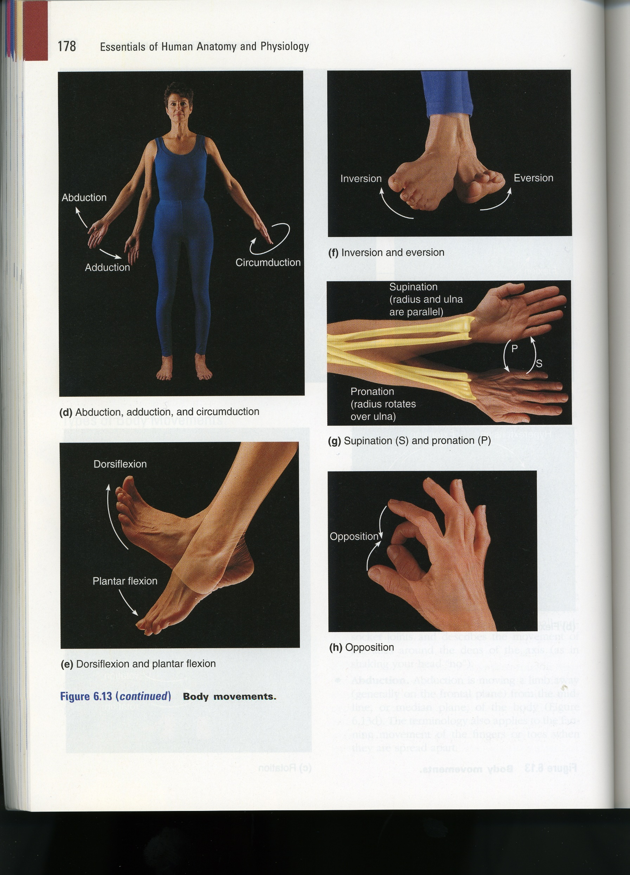

INVERSION AND EVERSION
DORSIFLEXION AND PLANTAR FLEXION

Slide 36

SUPINATION AND PRONATION

Slide 37

OPPOSITION

Slide 38
Biomechanics of Knee joint
The knee joint is one of the most complex and important joints in the human body. It is responsible for supporting body weight, allowing various types of movement, and providing stability. The biomechanics of the knee joint involve the study of its structure, function, and the forces acting on it during different activities.
The knee joint is a major load-bearing joint in the lower extremity.
The knee is the largest joint and replicates a modified hinge joint. The knee joint is an essential joint in the skeletal system responsible for human locomotion and is vulnerable to injuries during sports activity.

Slide 44
Circulatory system
The circulatory system, also known as the cardiovascular system, is a vital organ system in the human body responsible for the transport of blood, nutrients, gases, and waste products throughout the body.
It consists of the heart, blood vessels, and blood
The primary function of the circulatory system is to maintain a constant flow of blood, delivering oxygen and nutrients to cells and tissues while removing carbon dioxide and waste products from the body.
The circulatory system works in coordination with other systems in the body, such as the respiratory system (to exchange gases), the digestive system (to absorb nutrients), and the excretory system (to eliminate waste products). Through this intricate network, the circulatory system helps maintain homeostasis and ensures the proper functioning of organs and tissues in the human body. Any disruptions or diseases affecting this system can lead to serious health issues.

Slide 45
Modeling the flow in blood vessels
Modeling the flow of blood in blood vessels is a complex and important area of study in biomedical engineering, physiology, and fluid dynamics. Understanding blood flow patterns can help in diagnosing and treating various cardiovascular diseases and optimizing medical devices like stents and artificial heart valves. There are several approaches to model blood flow in blood vessels:
Mathematical Models: Mathematical models use equations and numerical methods to simulate blood flow. The most common approach is to apply the Navier-Stokes equations, which describe the motion of fluids. However, since blood is a non-Newtonian fluid (its viscosity changes with shear rate), more sophisticated models like the Navier-Stokes equations with a non-Newtonian viscosity term or power-law models are often used.

Slide 46
The Navier-Stokes equations
The Navier-Stokes equations consist of two equations, one for conservation of momentum and another for conservation of mass (also known as the continuity equation):
Conservation of Momentum (Navier-Stokes equation):
ρ * ( ∂v/∂t + v ⋅ ∇v ) = -∇P + μ * ∇^2v + ρ * g
Here:
ρ is the fluid density (mass per unit volume).
v is the velocity vector of the fluid.
t is time.
P is the pressure.
μ is the dynamic viscosity of the fluid (a measure of its resistance to shear deformation).
∇ is the gradient operator (a vector operator that represents the rate of change of a scalar field in space).
∇^2v is the Laplacian of the velocity vector (the divergence of the gradient of the velocity).
g is the acceleration due to gravity.
This equation describes how the velocity of the fluid changes over time and space due to various forces, including pressure gradients, viscous forces, and gravity.

Slide 47
The Navier-Stokes equations
Conservation of Mass (Continuity equation):
∂ρ/∂t + ∇ ⋅ (ρ * v) = 0
This equation expresses the conservation of mass in a fluid. It states that the rate of change of fluid density at any point in the domain is equal to the negative divergence of the mass flow rate (ρ * v) at that point.
Solving the Navier-Stokes equations analytically is often challenging, if not impossible, for most real-world problems due to their non-linearity and complexity. Instead, researchers use numerical methods, such as computational fluid dynamics (CFD), to approximate solutions for practical applications. CFD simulations involve discretizing the equations and solving them iteratively on a computational grid to predict the behavior of fluids under different conditions. These simulations have revolutionized engineering design and research, allowing for better understanding and optimization of fluid flow phenomena.

Slide 48
Power-Law
In fluid dynamics, a power-law model is commonly used to describe the behavior of non-Newtonian fluids. Non-Newtonian fluids are those that do not follow Newton's law of viscosity, which states that the shear stress in a fluid is directly proportional to the rate of shear strain (velocity gradient). Instead, the viscosity of non-Newtonian fluids depends on the applied stress or the rate of deformation.
The power-law model for a non-Newtonian fluid relates the shear stress (τ) to the shear rate (du/dy) through the following equation:
τ = K * (du/dy)^n
where:
τ is the shear stress (force per unit area).
K is the consistency index or flow consistency coefficient (a measure of the fluid's resistance to flow).
du/dy is the shear rate (velocity gradient) along the direction of flow.
n is the flow behavior index or power-law exponent (dimensionless parameter).

Slide 49
The power-law exponent (n) determines the shear-thinning or shear-thickening behavior of the fluid:
If 0 < n < 1, the fluid exhibits shear-thinning behavior, where its viscosity decreases as the shear rate increases. Many common non-Newtonian fluids, such as some polymer solutions and suspensions, display shear-thinning behavior.
If n = 1, the fluid behaves as a Newtonian fluid, and its viscosity remains constant regardless of the shear rate. In this case, the power-law equation simplifies to the linear relationship τ = K * (du/dy).
If n > 1, the fluid exhibits shear-thickening behavior, where its viscosity increases as the shear rate increases. Shear-thickening behavior is less common than shear-thinning behavior and can be observed in certain concentrated suspensions and non-Newtonian fluids like cornstarch and water mixtures (commonly known as "oobleck").
The power-law model is a simplified representation of non-Newtonian behavior and is suitable for many practical engineering applications. However, it is essential to note that different non-Newtonian fluids may exhibit more complex rheological behavior, and other more sophisticated models may be needed to accurately describe their flow characteristics.
Various other models, such as Bingham plastic, Herschel-Bulkley, and Casson models, are also used to describe the behavior of specific types of non-Newtonian fluids.

Slide 50
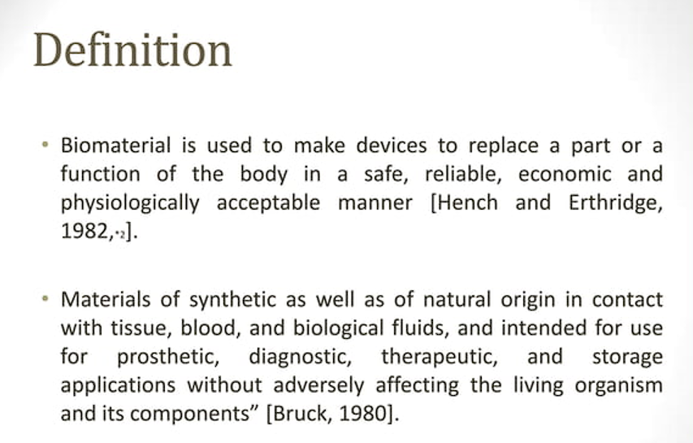
Biomaterials

Slide 51
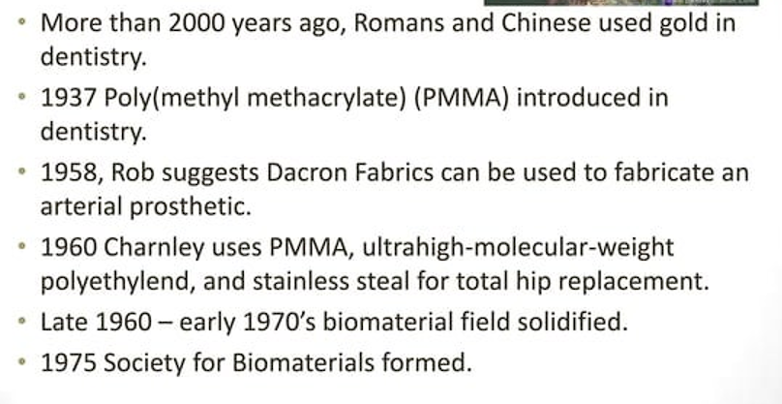
Histrory

Slide 52
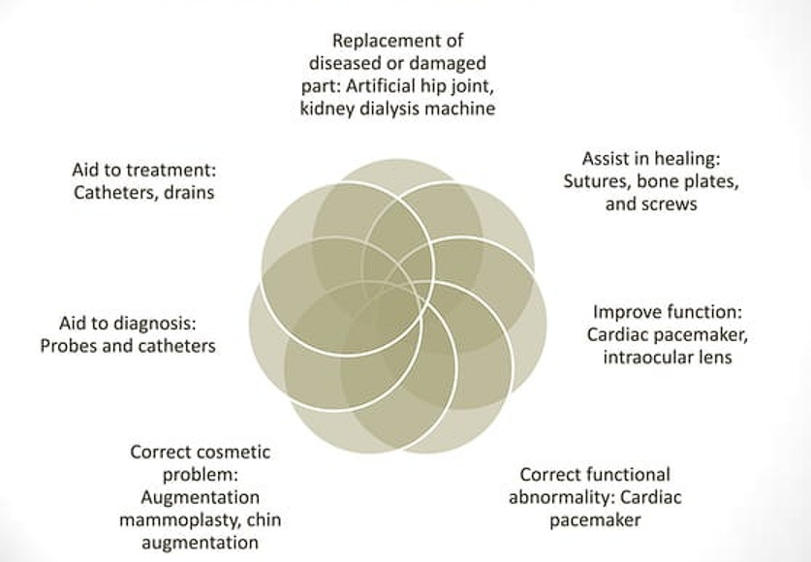
Uses of Biomaterials

Slide 53
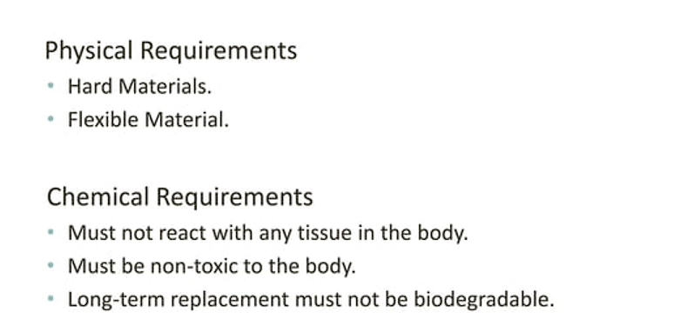
Characteristics of Biomaterials

Slide 54
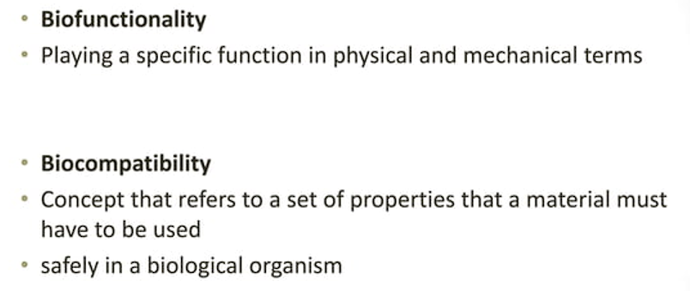
Main features for Medical applications

Slide 55
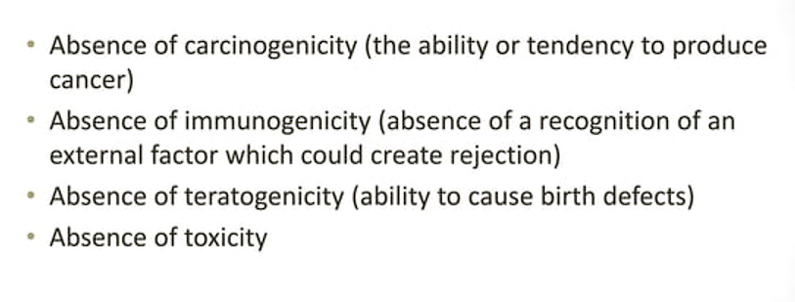
Biocompatible material features

Slide 56
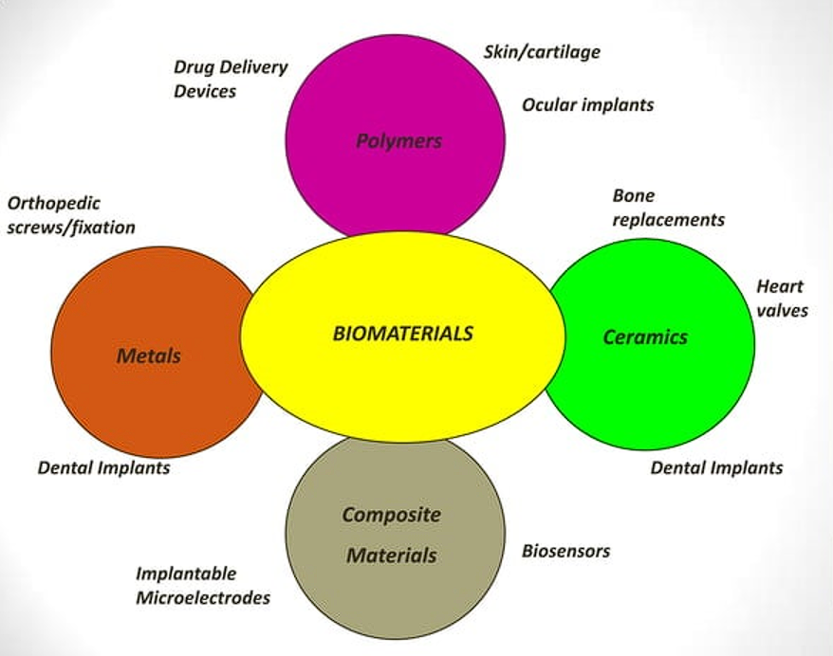

Slide 57
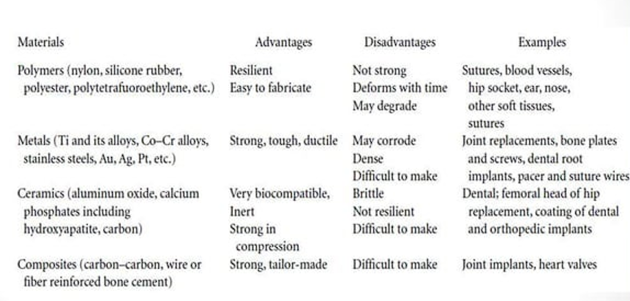
Materials for use in the Body

Slide 58
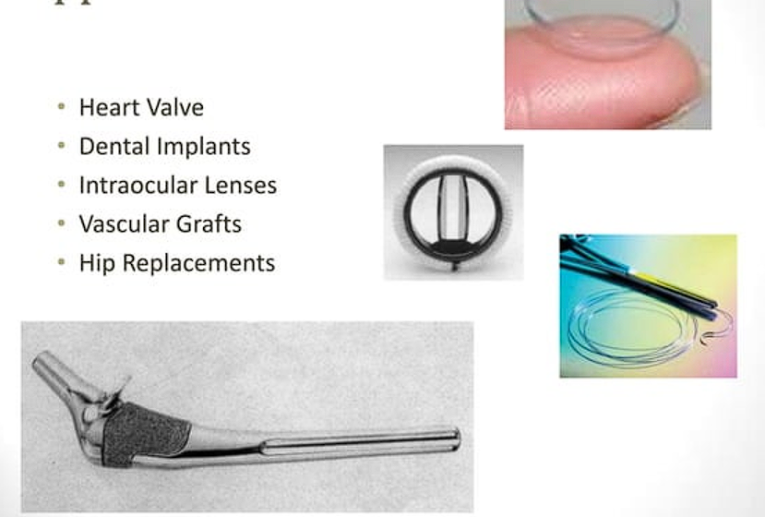
Examples of Biomaterial Applications

Slide 59


